Slide 1
Indian Election – Do they change Market Trends or Otherwise ?
Nooresh Merani
CEO – Analyse India
www.nooreshtech.co.in
www.analyseindia.com

Slide 2
Indian Elections
The period of consideration in the case we have taken is 1-3 months before the election result.
Major markets considered are Dow Jones,Dax, FTSE, Hang Seng,Nikkei,Taiwan and some more.
What was the peak to pit drop in various markets in the period before elections?
What was the trend post elections.

Slide 3
Indian Elections – 2004.
Black Monday – 17th May 2004

Slide 4
Nifty –17th May 2004 BJP loses Election
Down 32% in April-May
Down 12% on 17th May 2004. Up 8% on 18th May .Also a bottom for long term.
Down 24% from peak as per closing of 18th May.

Slide 5
U S Markets – 17th May 2004

Slide 6
Dow Jones in April-May 2004
Down 6.8% in April-May
Bottom made in 1-2% of the bottom
Down 1% on 17th May 2004. Also a bottom for short term.

Slide 7
European Markets – 17th May 2004

Slide 8
CAC – Bottom on 17th May 2004
Down 8.1% in April-May
Bottom made in 1-2% of the bottom
Down 1.2% on 17th May 2004. Also a bottom for short term.

Slide 9
DAX – Bottom on 17th May 2004
Down 10.7 % in April-May
Bottom made in 1-2% of the bottom
Down 1% on 17th May 2004. Also a bottom for short term.

Slide 10
FTSE – Bottom on 17th May 2004
Down 5 % in April-May
Similar bottoms of past few months
Down 1.2% on 17th May 2004. Also a bottom for short term.

Slide 11
Asian Markets
17th May 2004

Slide 12
Hang Seng – on 17th May 2004
Down 17 % in April-May
Down 22 % from peak.
Most co-related index to Nifty/Sensex
Down 2.7% on 17th May 2004. A bottom not seen again till 2008

Slide 13
Nikkei – 17th May 2004
Down 14 % in April-May
Down 3% on 17th May 2004. A major bottom made.
Similar bottoms of past few months

Slide 14
Taiwan – 17th May 2004
Down 24% in April-May
co-related index to Nifty/Sensex
Down 5 % on 17th May 2004. major bottom near it

Slide 15
Emerging Markets & more
17th May 2004

Slide 16
Brazil – on 17th May 2004
Down 28 % from peak.
Down 24 % in April-May
Remember BRIC ?
A long term bottom made on 17th May 2004

Slide 17
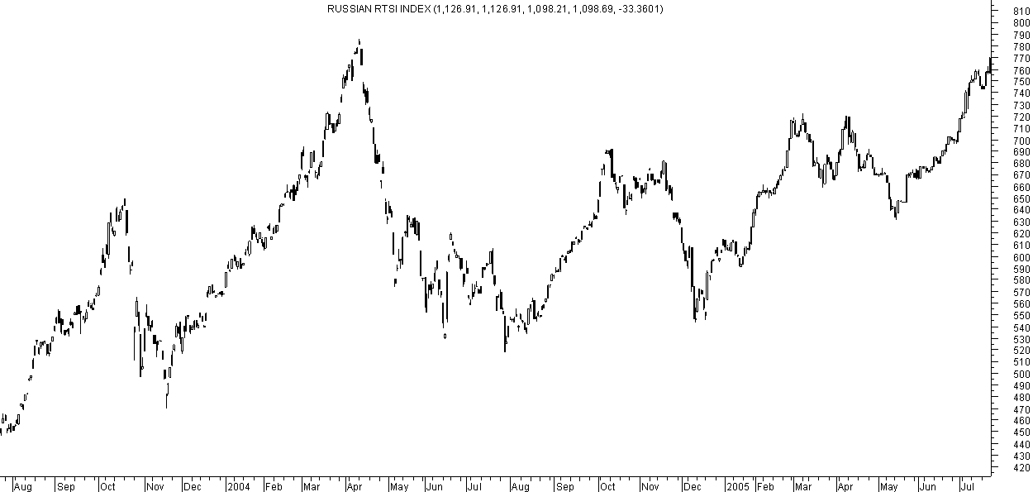
Russia – May 2004
Down 20 % in April-May
Remember BRIC ?

Slide 18
Argentina – May 2004

Slide 19
KLSE – May 2004

Slide 20
Indian Election 2009
Upper Circuit Day - 18th May

Slide 21
Nifty – Upper circuit day
Circuit barrier on 18th May 2009.
Up 73% by next day
Down 65 % from peaks of 2007-2008
Up 45% pre-election

Slide 22
Hang Seng – 2009
Up 68% by August 2009.
Reducing underperformance with Nifty
Down 66% from peaks
Of 2007
Up 56 % before Indian Elections

Slide 23
Taiwan – 2009
Up 75 % by Sept 2009.
Reducing underperformance with Nifty
Down 60 % from peaks
Of 2007
Up 61% before Indian Elections

Slide 24
Nikkei – 2009
Up 52% by end of 2009.
Reducing underperformance with Nifty
Down 55% from peaks
Of 2007
Up 39% before Indian Elections

Slide 25
Dow Jones – 2009
Up 53% by end of 2009.
Reducing underperformance with Nifty
Down 54% from peaks
Of 2007
Up 32 % before Indian Elections

Slide 26
CAC – 2009
Up 58% by end of 2009.
Reducing underperformance with Nifty
Down 60% from peaks
Of 2007
Up 36% before Indian Elections

Slide 27
Dax – 2009
Up 64% by end of 2009.
Reducing underperformance with Nifty
Down 55% from peaks
Of 2007
Up 39% before Indian Elections

Slide 28
Indian Election 2014
Global Trends

Slide 29
Hang Seng – 2014

Slide 30
Taiwan – 2014

Slide 31
Nikkei – 2014

Slide 32
Dow Jones – 2014

Slide 33
FTSE – 2014

Slide 34
CAC - 2014

Slide 35
DAX – 2014

Slide 36
Conclusions
US markets continues in a strong long term uptrend with intermittent corrections. It is actually a start of multi-year structural bull market.
European Markets are close to turning around into long term uptrends. DAX is already in a structural bull market.
Asian Markets on verge of a structural bull market which can start from any time between mid of 2014 to end of 2014.

Slide 37
Nifty – Trend in 2014
Nifty in new highs and RSI also breaking out.

Slide 38
Nifty - Can it breakout ?
Nifty can see a jump to 7000-7200 on a breakout above 6600 with pre-election polls etc

Slide 39
Asian Markets Co-Relation
Hang Seng is down 8-10% from recent peaks. Nifty is up 3% from recent peaks.
A new structural bull market may need all Asian indices to scale up into breakouts.
After a multi-year breakout we may not get into a long term bull market without a retest.
Nifty may possibly test a zone of 7000-7200 in pre-election rally but that could be a time to book out given the volatility with Election Results.

Slide 40
Nifty – Election Possibilities
-> In case of a breakout without global support pre-election to 7000-7200 is a good zone to book profits.
-> The recent lows at 5900 become an important support levels for any further corrections. Dips to 5900-6200 become a buy.
-> Essentially with a not so supportive asian and global markets we need to be cautious and focus on midcaps as they tend to outperform irrespective of outcome of elections ( See the next slide)

Slide 41
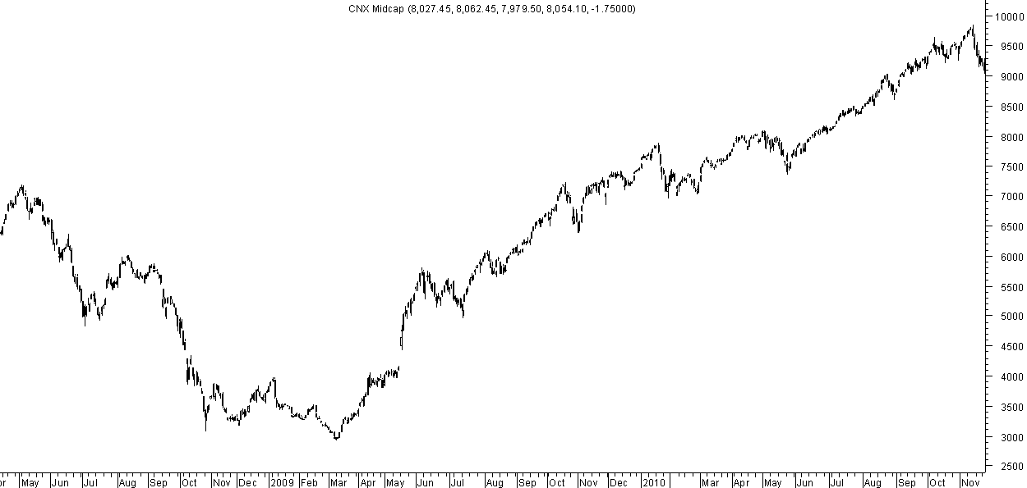
CNX MIDCAP AND NIFTY
CNX Midcap 111% rise against 46% of Nifty ( 4323 to 6300 )
Up 24% post election
CNX Midcap was up 42% pre-election. Underperformed Nifty which was up 46%

Slide 42
Post Election Opportunities
In 2004/2009

Slide 43
Nifty 2004 – Retraces 50% of the move to give entry
Nifty gives an
Entry point to both post the event jump/dump
The dip post election becomes a bottom for a very long time to come.

Slide 44
Nifty 2009 – Gives an opportunity retraces 60% of the move.
The dip post election becomes a bottom for a very long time to come. We have
Still not seen 4000 Nifty
Nifty gives an entry point. Retraces 60% of the post election move.

Slide 45
Conclusion
Strategy should be to get out at a pre-election rally if it comes.
The best opportunity comes when the euphoria or the pessimism dies down over the next 3 months.
The bottom made in that period could be an important bottom for very long period of time.
The trends are set post elections for a meaningful rally whether the government performs or does not.
Also we find no co-relation to the Election results but more so with the global market trends. .
As of now the global trends are not conducive like 2009 so better be cautious at levels of 7000 or higher.

Slide 46
Sector Leadership- Last 5 years

Slide 47
Sectoral View.
One of the classical beliefs of Technical Analysis is to follow the trend and leaders.
So any sector which crosses 3/5/10/20 year high is the first signal of leadership.
Buying low is not the best option for supernormal returns.
Buying new highs is the way to go.
Lets look at the leaders ( FMCG/Healthcare) of 5 years and we notice similar characteristics. Although signals came at different times.

Slide 48
BSE Healthcare – End 2010

Slide 49
BSE FMCG – Middle of 2009
Middle of 2009. HUL broke 12 yr highs

Slide 50
Sector Leadership- Probable for Next 5 years?

Slide 51
BSE IT – Has already lead the index recently but a 15 year high cross implies more to come

Slide 52
BSE OIL and GAS – If can breakout 9500 will be a 3-5 year high

Slide 53
Bse Capital Goods – Close to breaking out above 3 year highs.

Slide 54
Midcap/Smallcaps Confirm Worst is Over and a Start of a Bull Market.

Slide 55
BSE Midcap Index – Crossing new highs post double Bottom

Slide 56
BSE Smallcap – The worst is over and a bull market has started already

Slide 57
The Chart which will confirm a Structural Bull Market

Slide 58
BSE DOLLEX – Yet to cross 3 year highs. Still 6-7% away

Slide 59
Dow Jones and Sensex
Long Term Technical
Targets at 32k/77k

Slide 60
Sensex – Its never been Better for equities in Last 10 -20-30 years.
Although we see a lot of buzz about new highs on Sensex. This is after 6 years. Returns of 6 years 0%. A 10 yr return is 14.8% ( this had a period of 2004-2007 bull market). A 20 year return is a just 9% ( this does not beat the fixed deposit return).
So how long should long term be ? In an asset which has a drawdown risk of 60% ( Remember 2008 crash )
We hear a lot of jazz about 15-19% CAGR on Sensex by every financial expert who suggests buy and hold for long term. This data is not reliable because of the big run in 1980s. ( It went up 40 times in 1979-1992). We wont get a period ever in decades to come? Also how many mutual funds were present in 1980s ? How many companies closed shop for every Infosys/Wipro/Dr Reddys.
So essentially CAGR growth in equities has been terrible over last 20 years. Its been pathetic over the last 6 years. The conclusion in this case is the adage – Time in the market is more important than timing the market is being tested for investors. Also the 15-19% CAGR of Sensex is unreliable.
Statistically we believe the best times for investors are when 5-10-20 year CAGR returns do not beat fixed returns and vice versa.
We believe sentimentally ( No IPOs, No NFOs only Real Estate advts) ,statistically ( terrible 20 yr CAGR, 50% down small cap index), technically ( disbelief, wall of worries ) the current 3-6 months window is essentially the best period for a big lumpy return over the next 1-4 years.
As a movie dialog says – Abhi to Picture Baki hai Mere Dost !!!

Slide 61
DOW JONES !!
Pole-: 1932 1966 ( 34 yrs)
Channel : 1942-1966 ( 24 yrs 10.8 times)
Flag: 1966-1983 ( 17 yrs of no growth)
First Phase: 1984-1987 ( 2 times in 3 yrs)
New High: in 22 mths
Top : in 17 years
SENSEX
Pole-: 1979-1992 ( 13 yrs)
Channel : 1988-1992 ( 4 yrs 10 times)
Flag: 1992-2005( 13 yrs of no growth)
First Phase: 2005-2008( 3 times in 3 yrs)
NEW HIGH : Same high in 24 months .
3 years of sideways move.
TOP : ( Ideally by 2018
Minimum 27k-32k or 77k.)

Slide 62
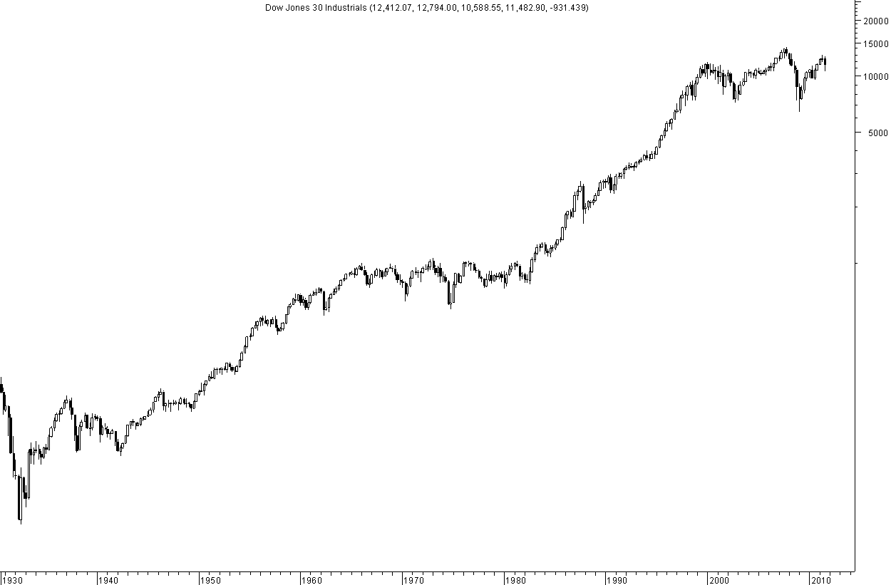
A terminal breakdown below the trendline before the big rally
A long parallel channel
Almost Double Bottom close to trendline
A long parallel channel
A terminal breakdown below the trendline before the big rally

Slide 63
Sensex at an Inflection point
On the long term charts Sensex/Nifty crossing into new highs coupled with broader markets in a strong uptrend after a long time.
Global Markets on an inflection point for multi year breakouts is an indication there might be a lag for a breakout but its not far.
Dow Jones went up 10-11 times in the 1980s. Will Sensex go up 10-11 times from the 2005-2018 period and go towards 32k/77k in the future.
By the way if we do reach our target of 77k by 2018 it would still be only 14% CAGR from 2008 !!

Slide 64
Conclusions
Ride the pre-election rally till 7000-7200. Get cautious in the zone around it.
Bigger opportunities are created in the next 3 months of elections.
Global markets at an inflection point and can signal a structural bull market by end of 2014.
Midcaps and Smallcaps have started a bull market and indicating every dips a buy for long term investors.
Oil and Gas, Capital Goods and IT would be the sectors which could create big winners.
Watch for Dollex 30/Hang Seng/Taiwan markets to give signals for a structural bull market start.
Nifty may be in new highs but the first high does not start a bull market but a retracement is the best opportunity.
Get ready for one of the best periods for equities in many decades. Buy in 2014 to sell in 2018 directly.

Slide 65
Services
QuickGains Premium Newsletter PLUS
Trading Recommendations on Yahoo/Sms
QuickGains Newsletter
Nifty Technical View and Positional bets sent via E-mail.
Big Value
Techno Funda Bets with Long Term View.
Platinum Plus
Limited High Conviction Recommendations
Market Turnaround Guidance
Customized Individual Service.
Trading and Investment Advisory/Consulting
Customized portfolio advisory for Ultra HNIs, Brokers and more.
TECHNICAL ANALYSIS TRAINING PROGRAM – CLASSROOM and WEB BASED.
For More Details check --- www.analyseindia.com or mail us on analyseindia@analyseindia.com

Slide 66
Team Analyse India
Nooresh Merani
CEO - Analyse India
Cell: +91-9819225396
e-mail: nooreshtech@analyseindia.com
N S Fidai
Managing Director - Analyse India
Cell: +91-9920120878
e-mail: nsfidai@analyseindia.com
Ankit Chaudhary
Technical Analyst and Derivative Strategist - Analyse India
Cell: +91-9899899989
e-mail: ankit@analyseindia.com

Slide 67
Disclaimer
As investment & trading consultants, Promoters, owners, families, relatives, friends and clients of www.nooreshtech.co.in maybe having positions in stocks / securities mentioned on the web site
All recommendations in this website are based on subject of Technical Analysis and do not reflect the fundamental validity of the stocks / securities. Authors / owners of Technical View by Nooresh will not be held responsible for any losses, financial or otherwise, incurred. To clarify, a ‘user’ is defined as anybody that visitshttp://www.nooreshtech.co.in, regardless of whether or not the have registered as a member of the website. ‘Site’ and the ‘community’ and‘www.nooreshtech.co.in’ are used interchangeably and refer to the URL http://www.nooreshtech.co.in and all sub-domains. The administrators and owners ofhttp://www.nooreshtech.co.in do not guarantee the reliability or completeness of any information provided on our site or in any hyperlink appearing on our site. Any advice or information presented on the site has not been verified by http://www.nooreshtech.co.in and does not represent the opinions of the same. Users of the site should not rely on the accuracy of any content on the site or assume any information they read on the site to be factual.http://www.nooreshtech.co.in, its administrators or owners will not be liable for any loss or damage caused by a user’s reliance on any information obtained from our site, or from a hyperlink found on our site. Members remain responsible for their own investments and should always conduct their own independent research before making independent investment decisions. If you choose to trade on the information, including but not limited to opinions or stock picks found on http://www.nooreshtech.co.in or any hyperlinks found on the site, then you have made a conscious, willing, free and personal decision to do so, and http://www.nooreshtech.co.in does not take any responsibility for this action.
By using http://www.nooreshtech.co.in you agree to be bound by the Terms and Conditions outlined below. If you don’t wish to be bound by the Terms and Conditions then do not complete this registration, and do not usehttp://www.nooreshtech.co.in or any of its associated services. We (the administrators and owners of http://www.nooreshtech.co.in) reserve the right to change these terms at any time, but will post a notice in advance on this website of any material changes. Following an update being posted, your continued use of http://www.nooreshtech.co.inimplies acceptance of the modified terms and conditions. All of the Content onhttp://www.nooreshtech.co.in remains the property ofhttp://www.nooreshtech.co.in. By “Content” we mean any information or materials found onhttp://www.nooreshtech.co.in. The harvesting of data from our site via automated means of any type, without the prior permission of http://www.nooreshtech.co.in is forbidden, as is attempting to access our site by any means other than through the interfaces we provide for accessing the site.

Slide 68
Disclaimer
You may make one copy of Content for your personal, non-commercial use as long as it is clearly labeled with “Intellectual Property of http://www.nooreshtech.co.in. All rights reserved”. Any other copying, distribution, storing, or transmission of any kind, or any commercial use of our Content, is prohibited without http://www.nooreshtech.co.in prior written permission. You may not republish, post, transmit or distribute Content to online bulletins or message boards, blogs, chat rooms, intranets or anywhere else without our consent. Notwithstanding the above, when you post Content, you do not surrender your copyright. You agree that http://www.nooreshtech.co.in a has an unlimited and perpetual license to republish the Content. However, you retain the right to use your words, images and other copyrightable content however you wish. We will always endeavor to ensure any content you publish is presented in context, and we’ll credit you (under your user name) as the author. We won’t republish your content in advertising without notifying you in advance and will not publish content in advertising if you instruct us not to.
As a member of http://www.nooreshtech.co.in , you agree to behave honestly at all times and act for the benefit of the users of the site. You, as a user of http://www.nooreshtech.co.in must not:
Post content that is not your own, or that is harmful, irrelevant, nonsensical, obscene, abusive, solicitous, fraudulent, or defamatory.
Misrepresent your true identity, motives and opinions
Take any action that places an unreasonable strain or disrupts the functioning of the site and its services
Copy the site’s content without prior permission from http://www.nooreshtech.co.in
Violate another member’s privacy
Violate any laws or regulations while using our site
If you don’t abide by the Code of Conduct, we will cancel your membership of the site.

Slide 69
Disclaimer
We collect information about who our members are and how they use our site in order to provide our members with the best experience possible. Sometimes we may use the information to notify you of products, services, specific content, or areas of our site that we think may interest you. You can choose whether or not to receive these notifications by altering your privacy settings at any time by contacting us at analyseindia@gmail.com Privacy whilst using the site When you post content onto our site, that information, along with your screen name, is visible to the public. Please remember that any information you disclose can be collected and used by others. Other members can respond to your posts at any time but will not know your external email address or other contact details (unless you have disclosed it).http://www.nooreshtech.co.in cannot guarantee the security of any information you transmit to us, and you do so at your own risk. You are responsible for maintaining the secrecy of any password and/or account information. We will never ask you for your password in an unsolicited phone call or email. If you are using a computer to which others have access, such as one in a computer lab, Internet cafe, or public library, always remember to log out and close your browser window when leaving our site. If you follow links from our site to others, you should be aware that you are doing business with those other sites, which have their own privacy and data collection practices. http://www.nooreshtech.co.in has no responsibility or liability for these sites.
Use of this site is subject to express Terms & Conditions, Code of Conduct, Privacy Policy, and Disclaimer. By continuing past this page, you agree to abide by these terms. Any information provided onhttp://www.nooreshtech.co.in should not be construed as research, trading picks or recommendations, or investment advice and is provided with no warrants as to its accuracy. Company names, products, services and branding cited herein may be trademarks or registered trademarks of their respective owners. The use of trademarks or service marks of another is not a representation that the other is affiliated with, sponsors, is sponsored by, endorses, or is endorsed by http://www.nooreshtech.co.in

